Slide 1
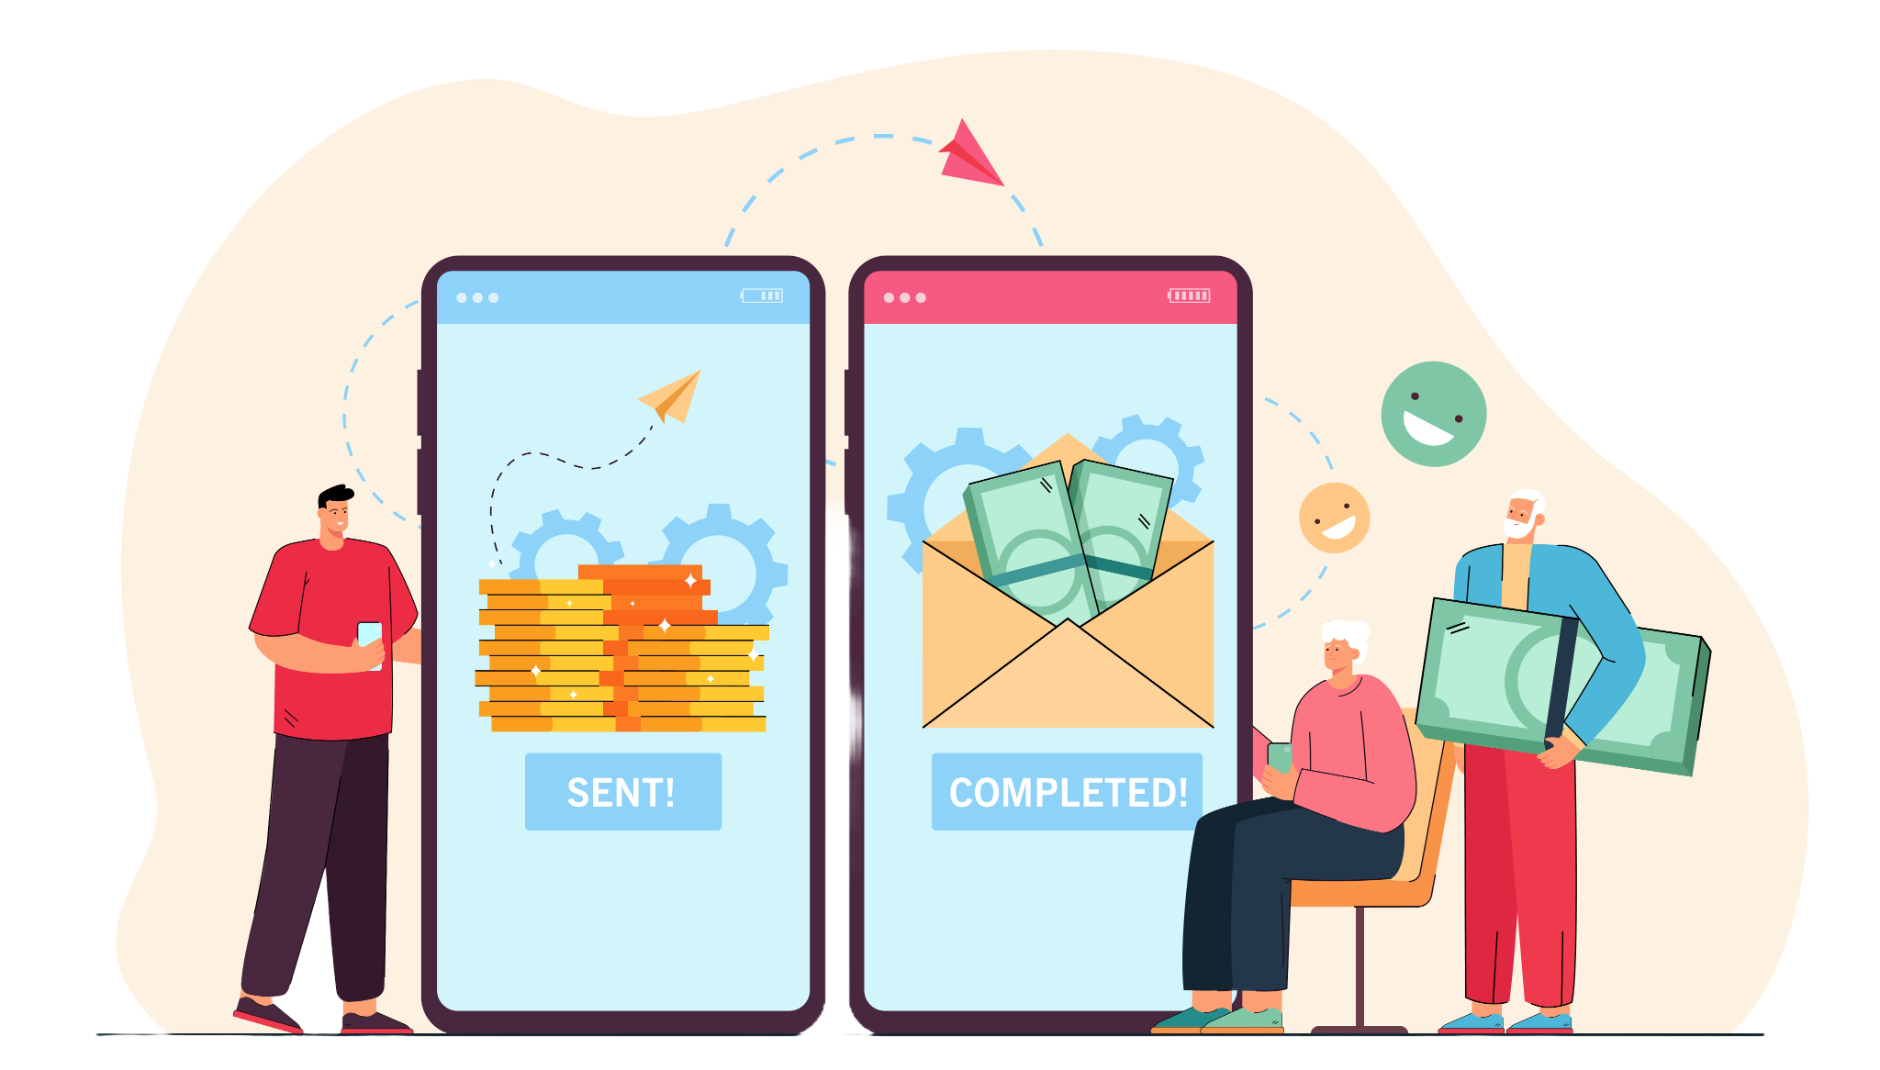
Use Case - Payment Processing
“Secure And Efficient Digital Payment Solution”
EZ-Pay
Notes:
Hello everyone! Welcome to the video session on Ways to Analyze Data.

Slide 2



Team Members
Meghna
Amrutha
Deepshika
Squad 4
Prerak
Atishay
Notes:
Add the respective deck Module /chapter details and its description

Slide 3
S. no | Topic Name
1 | Introduction
2 | Objectives
3 | Technical Requirement
4 | ER Diagram
5 | Class Diagram
6 | Use Case Diagram
7 | Functionalities
8 | Advantages
9 | Timeline
10 | Conclusion
Notes:
You can add any number of rows here in this table to fill all topic names for respective deck topics

Slide 4

Introduction
Introduction
Objectives
Technical Requirement
ER Diagram
Class Diagram
Use Case Diagram
Functionalities
Advantages
Timeline
Conclusion
Users can initiate transactions and choose the mode of payment.
Simplistic and user-friendly interface for great user experience.
Real-time tracking of transactions, and keeping customers
informed.
Notes:
Content Slide with Side bar, content and Image

Slide 5
Objectives
Introduction
Objectives
Technical Requirement
ER Diagram
Class Diagram
Use Case Diagram
Functionalities
Advantages
Timeline
Conclusion
Initiation
Processing
Failures
Authorization
Tracking

Slide 6
Assumptions
Introduction
Objectives
Technical Requirement
ER Diagram
Class Diagram
Use Case Diagram
Functionalities
Advantages
Timeline
Conclusion
User is logged in successfully.
User has a registered and linked UPI ID.
User has registered and verified bank account details.
Users provide accurate information.

Slide 7
Payment Workflow
01
Initiating a Payment
User selects the "Payment" option.
User inputs payment details (amount, payment method, recipient).
System initializes the payment process.
Introduction
Objectives
Technical Requirement
ER Diagram
Class Diagram
Use Case Diagram
Functionalities
Advantages
Timeline
Conclusion
02
Authorizing a Payment
User authorizes the payment using a preferred method (e.g., Transaction PIN).
System validates the authorization.
If authorization is successful, the system proceeds to the next step.
03
Processing the Payment
System processes the payment by debiting the user’s account and crediting the recipient.
System communicates with the payment gateway or bank to complete the transaction.
04
Recording Payment Status
System provides real-time updates on the payment status (Initiating, Processing, Success, or Failure).
User can view the payment status in the transaction history.
05
Handling Payment Failures
In case of failure, the system notifies the user with the failure reason.
User can retry the payment or select an alternate method.
System logs the failure.
Notes:
Content Slide with Side bar, content and Image

Slide 8







Technical Requirement
Introduction
Objectives
Technical Requirement
ER Diagram
Class Diagram
Use Case Diagram
Functionalities
Advantages
Timeline
Conclusion
Technologies Used:
Java and Spring
React
Oracle SQL
Software Requirements:
VS Code
Eclipse
MS Excel
Notes:
Content Slide with Side bar, content and Image

Slide 9
Concepts Used
Introduction
Objectives
Technical Requirement
ER Diagram
Class Diagram
Use Case Diagram
Functionalities
Advantages
Timeline
Conclusion
Java
Spring Framework
Database
React
> Object Oriented Programming
> Exception Handling
> Collections Framework
> Spring Boot for RESTful APIs
> Dependency Injection
> Transaction Management
>Component-based Architecture
> State Management with Hooks
> Fetch for API Calls
> Tables
> Stored Procedure
> Transaction Handling
Notes:
Content Slide with Side bar, content and Image

Slide 10

Three Tier Architecture
Introduction
Objectives
Technical Requirement
ER Diagram
Class Diagram
Use Case Diagram
Functionalities
Advantages
Timeline
Conclusion
Layer Type | Logical Layer | Tech stack
Presentation |  | React for Frontend, HTML, CSS, JavaScript
Business |  | Java, Spring Boot for Business Logic, REST API
Data Access |  | Java, Spring Data JPA, Hibernate
Validations
User Mgmt
Reports
Game Navigation
Validation
Service
Configuration
Game Logic
Validations
Oracle 19C
Notes:
Content Slide with Side bar, content and Image

Slide 11
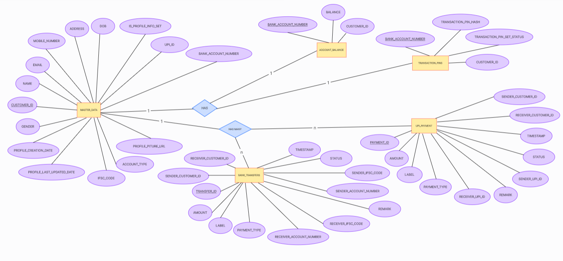
E-R Diagram
Introduction
Objectives
Technical Requirement
ER Diagram
Class Diagram
Use Case Diagram
Functionalities
Advantages
Timeline
Conclusion
Notes:
Content Slide with Side bar, content and Image

Slide 12
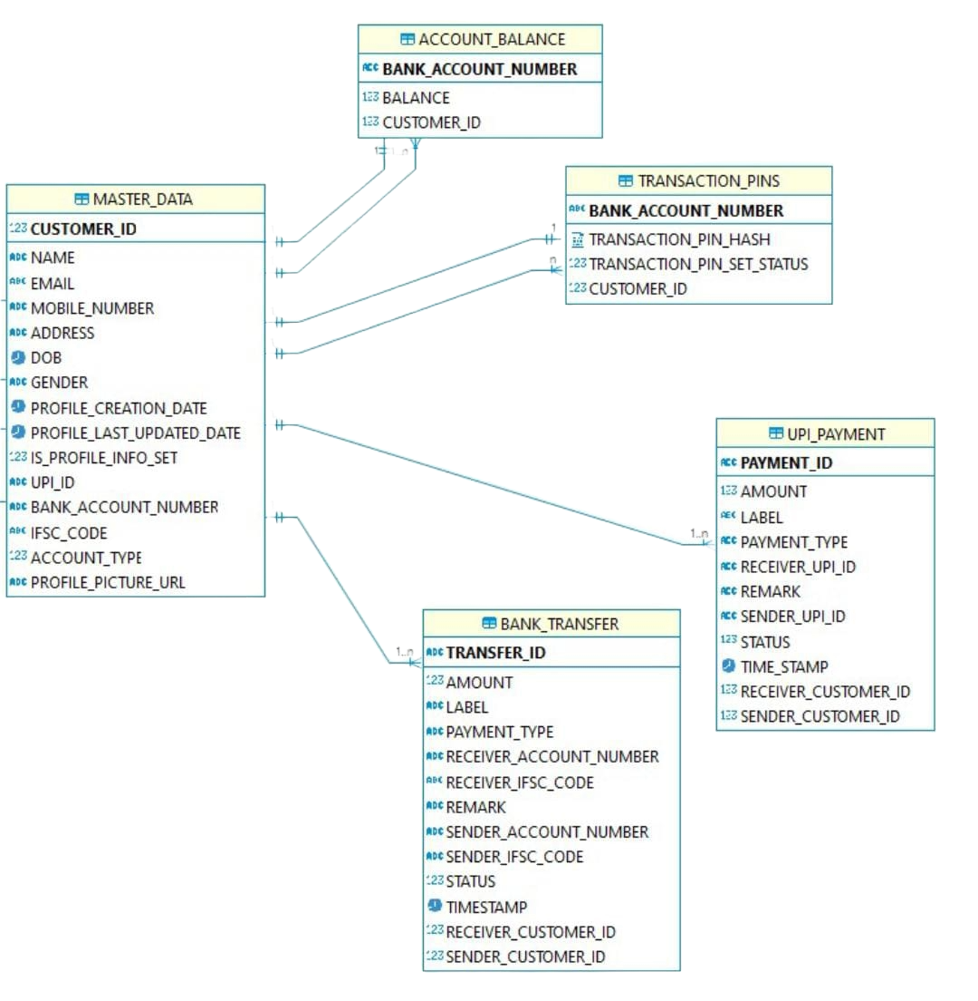
Class Diagram
Introduction
Objectives
Technical Requirement
ER Diagram
Class Diagram
Use Case Diagram
Functionalities
Advantages
Timeline
Conclusion
Notes:
Content Slide with Side bar, content and Image

Slide 13
Use Case Diagram
Introduction
Objectives
Technical Requirement
ER Diagram
Class Diagram
Use Case Diagram
Functionalities
Advantages
Timeline
Conclusion
Bank Linking
UPI Payment
User
Bank Transfer
Notes:
Content Slide with Side bar, content and Image

Slide 14
Functionalities
01
Setting Transaction Pin
User selects the "Set Transaction Pin" option.
User inputs pin details (set pin, confirm pin).
System displays success message.
Introduction
Objectives
Technical Requirement
ER Diagram
Class Diagram
Use Case Diagram
Functionalities
Advantages
Timeline
Conclusion
02
Linking user’s bank account
User’s bank Account is automatically linked.
Account is linked automatically when setting the pin
System displays success message.
03
Choosing payment option
User can choose between UPI payment or Bank to Bank transfer.
System provides interfaces for both for a seamless experience.
04
Authorizing payment
Users enter the receiver’s details( upi id/account number and ifsc code).
Users also have an option of adding a note along with their payments.
Users enter their pin to authorize the payment.
05
Payment status displayed
System provides Success, or Failure message.
In case of failure, the system notifies the user with the failure reason.
User can retry the payment or select an alternate method..
Notes:
Content Slide with Side bar, content and Image

Slide 15
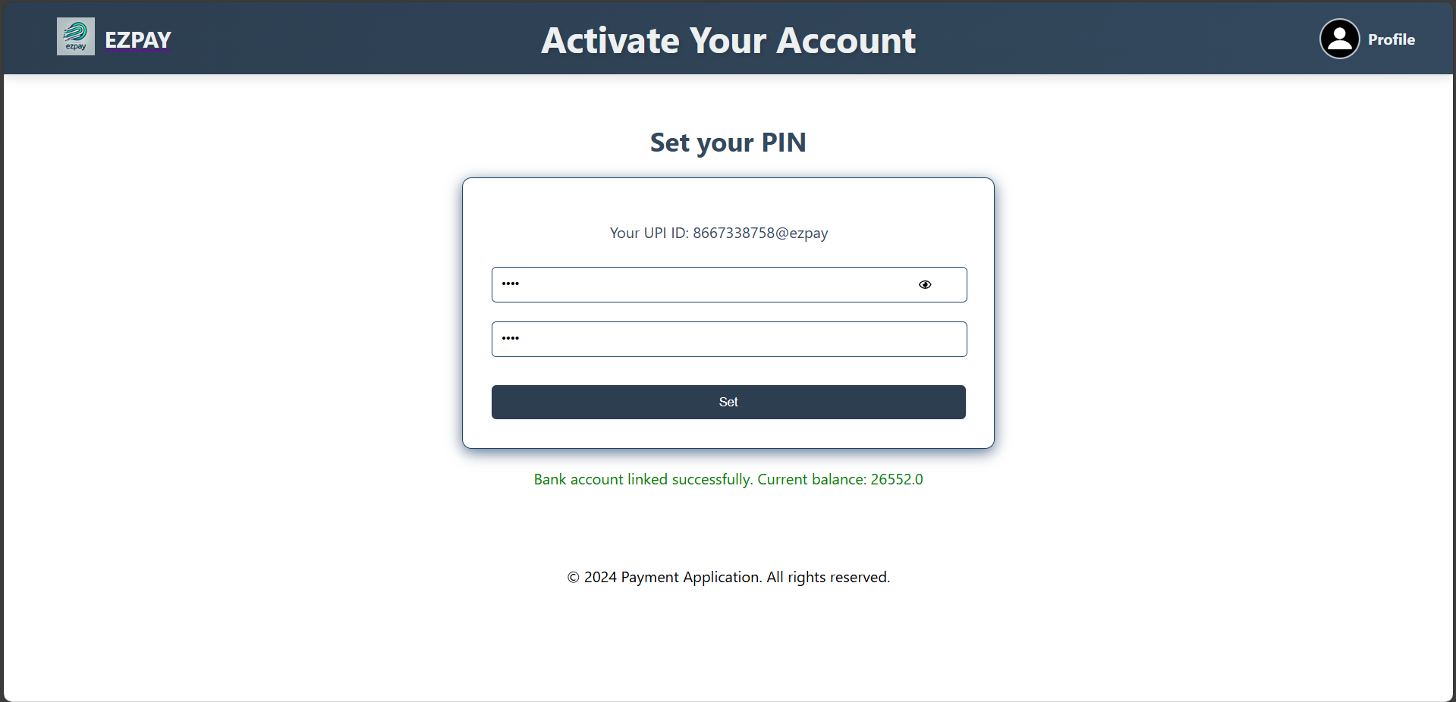
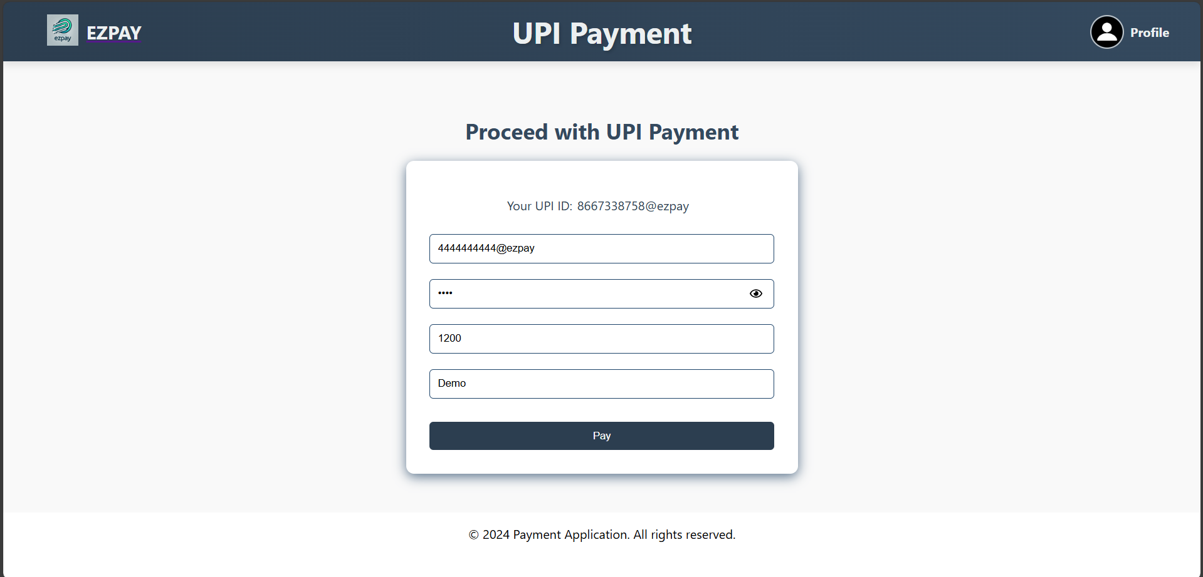
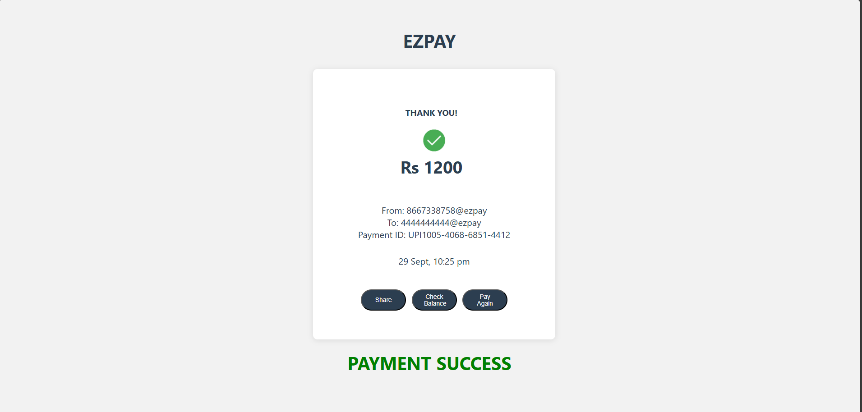
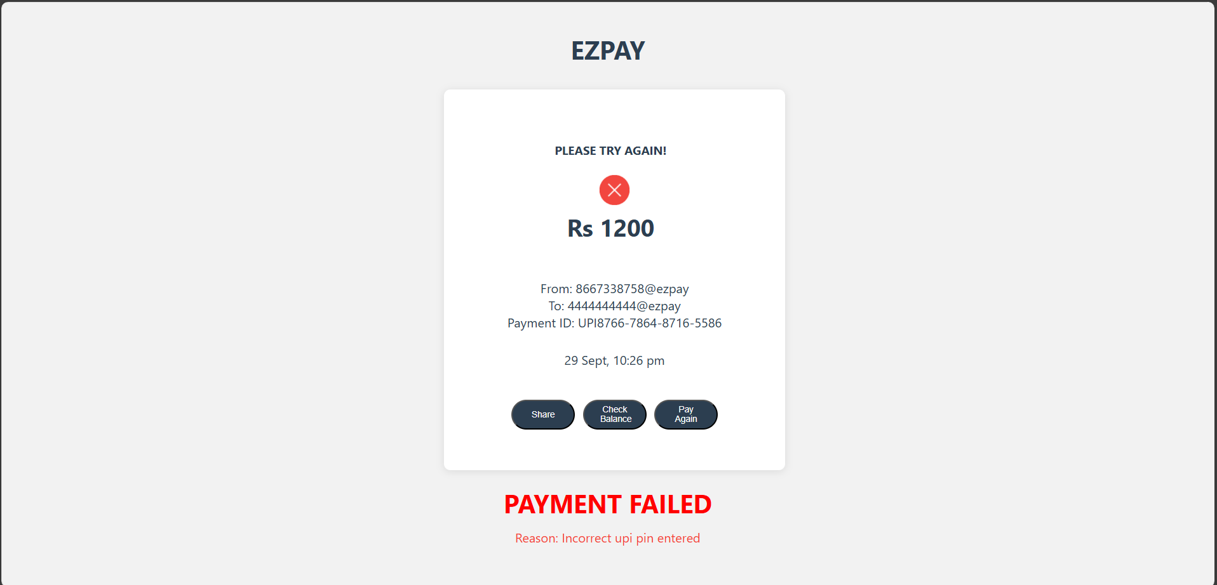
User Functions
Introduction
Objectives
Technical Requirement
ER Diagram
Class Diagram
Use Case Diagram
Functionalities
Advantages
Timeline
Conclusion
In this functionality the user can either opt for Bank Transfer or UPI Payment after setting their pin and linking their accounts.
Notes:
Content Slide with Side bar, content and Image

Slide 16
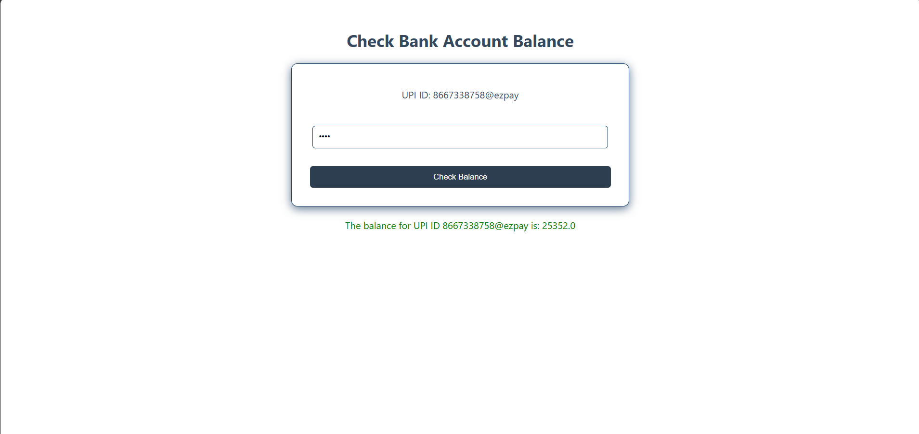
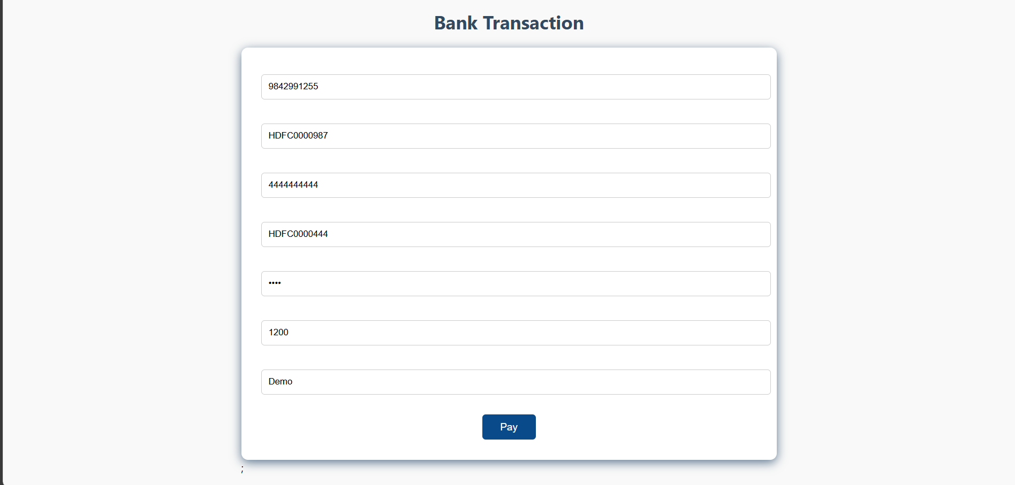
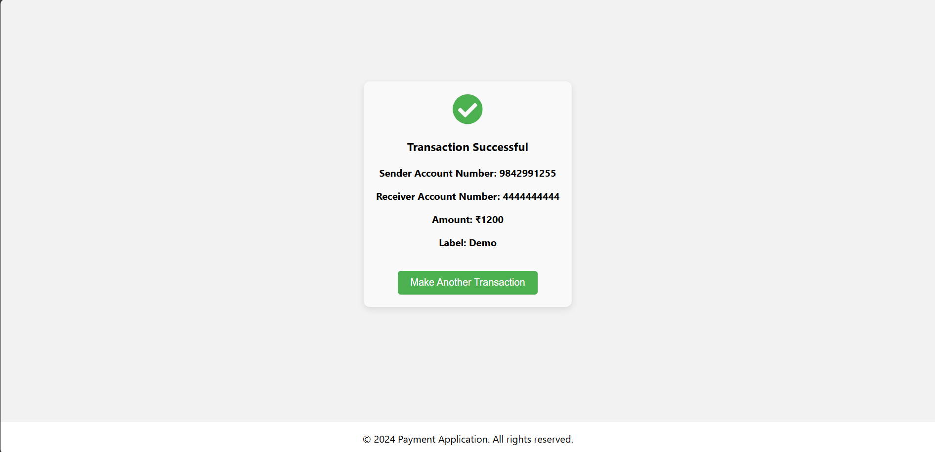
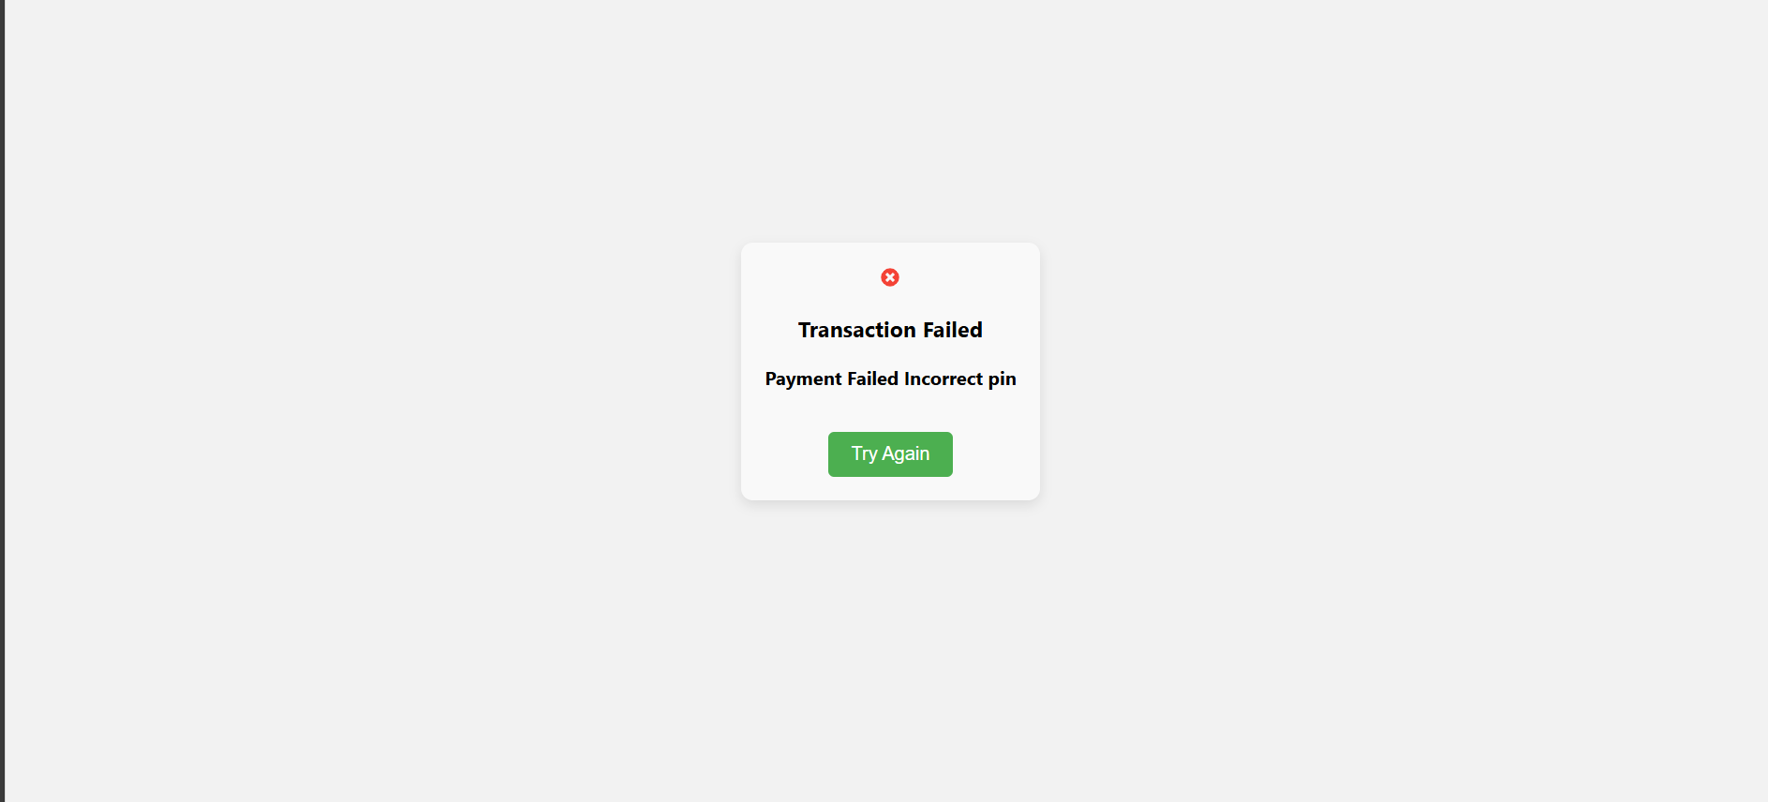
User Functions
Introduction
Objectives
Technical Requirement
ER Diagram
Class Diagram
Use Case Diagram
Functionalities
Advantages
Timeline
Conclusion
The User functionalities:
Notes:
Content Slide with Side bar, content and Image

Slide 17
Advantages
Introduction
Objectives
Technical Requirement
ER Diagram
Class Diagram
Use Case Diagram
Functionalities
Advantages
Timeline
Conclusion
1. Seamless Payment Initiation
Users can easily initiate payments with minimal steps, improving the overall user experience.
2. Secure Authorization Process
Advanced security measures, such as UPI Pin authentication, ensure that payments are authorized safely, protecting users from unauthorized transactions.
3. Real-time Tracking
Users receives a confirmation message updates on their payment status, allowing them to track every transaction in real time for better transparency and control.
4. Reliable Error Handling
In the event of payment failures, the system provides clear reason and allows users to retry payments or select alternate methods, ensuring a smooth user experience even in case of issues.
Notes:
Content Slide with Side bar, content and Image

Slide 18
Execution Approach
Introduction
Objectives
Technical Requirement
ER Diagram
Class Diagram
Use Case Diagram
Functionalities
Advantages
Timeline
Conclusion
PHASE 1
  Class and test cases/script development for EZ-Pay Payment process (Use case 2) Module
  Duration: 1 Week
PHASE 2
  Data access classes development for EZ-Pay Payment Process (Use case 2) Module
  Duration: 1 Week
PHASE 3
  Adding business logic layer, implement Spring Boot Data JPA for Payment Process Module
  Duration: 1 Week
PHASE 4
  Develop UI pages with React and CSS styling, integrate with spring boot data JPA for EZ-Pay Payment Process (Use case 2) Module
  Duration: 1 Week
PHASE 5
  Migration to Spring and implement CI/CD for EZ-Pay Payment Process (Use case 2) Module
  1 Week
Notes:
Content Slide with Side bar, content and Image

Slide 19
Methodology and Timeline
Sprint 1
12th- 21st AUG 2024
Introduction
Objectives
Technical Requirement
ER Diagram
Class Diagram
Use Case Diagram
Functionalities
Advantages
Timeline
Conclusion
  Create class/methods related to UPI Service Module and Banking Service Module
  Create test class/methods related to UPI Service Module and Banking Service Module
  Code review for the class/methods developed
Developers: Meghna, Deepshika
Testers: Amrutha, Atishay
Code Reviewer: Prerak
Sprint 2
22nd- 26th AUG 2024
  Create data access classes/methods related to UPI Service Module and Banking Service Module.
  Create test classes/methods for data access classes related to UPI Service and Banking Service Module
  Code review for the class/methods developed
Developers: Atishay, Prerak
Testers: Deepshika, Meghna
Code Reviewer: Amrutha
Sprint 3
4th- 12th SEPT 2024
  Develop business logic layer, Spring Boot Data JPA for UPI Service Module and Banking Service
  Test the business logic layer, Spring Boot Data JPA UPI Service Module and Banking Service
  Code review for the class/methods developed
Developers: Amrutha,Atishay
Testers: Deepshika, Prerak
Code Reviewer: Meghna
Sprint 4
14th- 23rd SEPT 2024
  Develop UI pages with React and CSS styling, integrate with Spring Boot Data JPA for UPI Service and Banking Service Module
  Develop data validation for pages related to UPI Service and Banking Service Module
  Review all the pages and validation code designed/developed
Developers: Meghna, Prerak
Testers: Amrutha, Deepshika
Code Reviewer: Atishay
Sprint 5
24th- 27th SEPT 2024
  Migration to Spring and implement CI/CD for UPI Service and Banking Service Module
  Test the migration to Spring and test CI/CD implementation of UPI Service and Banking Service Module
  Code review for the migration code developed
Notes:
Content Slide with Side bar, content and Image

Slide 20

Conclusion
Introduction
Objectives
Technical Requirement
ER Diagram
Class Diagram
Use Case Diagram
Functionalities
Advantages
Timeline
Conclusion
This project streamlines the entire payment process, making it efficient and secure for users to manage their transactions.
The system maintains comprehensive details of customers and their payment histories, providing transparency and accountability.
By automating tasks such as payment authorization and failure handling, the project minimizes manual efforts and ensures smooth, error-free transactions for both users and administrators.
Notes:
Content Slide with Side bar, content and Image

Slide 21

Questions?

Slide 22
Thank You!

